Slide 1

Digital Solution For Enforcing Social Distancing
DEPARTMENT OF COMPUTER ENGINEERING
Dr. DY PATIL SCHOOL OF ENGINEERING AND TECHNOLOGY CHAROLI(B.K), VIA LOHEGAON PUNE 412015
Presented By:
Shreyas Kumbhar (B151034232 )
Rohan Zinjurke (B151034277 )
Ashutosh Dhabekar (B151034218 )
Tanishq Kulthe (B151034231 )
Guided By: Prof. Bhagyashri Vyas
Group No: 18

Slide 2
Agenda
Problem Statement
Motivation
Objectives
Literature Survey
Proposed System
Advantages Of Purposed System

Slide 3
Working
Functional Requirements
Non Functional Requirements
System Requirements

Slide 4
Data Flow Diagram
Level O
Level 1
Level 2

Slide 5
UML Diagrams
1. Use Case Diagram
2. Class Diagram
3. Object Diagram
4. Sequence Diagram
5. Activity Diagram
6. Deployment Diagram
7. Component Diagram
8. Package Diagram

Slide 6
Problem Statement
Social distancing is deliberately increasing the physical space between people to avoid spreading illness.
Staying at least six feet away from other people lessens your chances of contracting COVID-19.
We can use OpenCV and YOLO to monitor/analyze whether people are maintaining social distancing or not.

Slide 7
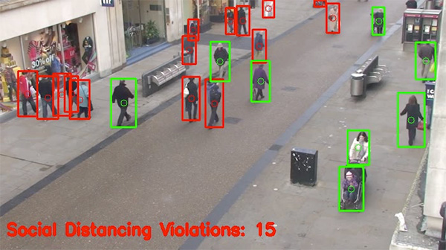
Motivation
In the fight against the COVID-19, social distancing has proven to be a very effective measure.
This Project capable of detecting distances between individuals and warning people that they should physically distance themselves from one another.

Slide 8
Objectives
To maintain safe distance between individuals.
To monitor social distance between people in public places.
Taking initiative to reduse spread of COVID-19 disease spread by maintaining safe distance.

Slide 9
Literature Survey
Sr. No | Paper Title | Author | Description | Year of publication
1 | Multiple Object Detection using OpenCV on an Embedded Platform | Souhail Guennouni, Anass Mansouri, Ali Ahaitouf | This paper Describes an overview of the cascade object detection algorithm. Then, it proposes an OpenCV-based solution for multiple object detection. | 2015
2 | The Realtime detection of traffic participants | Alexandra Corovic, Velbor Linc, Sinisa Dumnic | This paper describes the usage Of newest version of YOLO in the system. | 2016
3 | Monitoring COVID-19 social distancing with person detection and tracking via fine-tuned YOLO v3 | Narinder Singh Punn, Sanjay Kumar Sonbhadra and Sonali Agarwal | The article proposes an efficient real-time deep learning based framework to automate the process of monitoring the social distancing via object detection and tracking approaches | 2019
4 | A Vision-based Social Distancing and Critical Density Detection System for COVID-19 | Dongfang Yang, Ekim Yurtsever, Vishnu Renganathan, Keith A. Redmill | This Paper Proposes A Vision-based Social Distancing and Critical Density Detection System. | 2019

Slide 10
Sr. No | Paper Title | Author | Description | Year of publication
5 | Real time social distancing detector using deep learning algorithms. | Renkal Keniya Ninad Mehendale | This paper distinguish the Social distance pattern and classes them as violation or maintainance of social distancing. | 2019
6 | Applying deep learning algorithm to maintain social distance in public place through drone technology | Lalitha Ramadass, Sushanth Arunachalam and Sagayasree Z. | The purpose of this paper is to inspect whether the people in a public place maintain social distancing. | 2019
7 | The Visual Social Distancing Problem | MARCO CRISTANI1, ALESSIO DEL BUE2, VITTORIO MURINO3, FRANCESCO SETTI4, AND ALESSANDRO VINCIARELLI5 | In this paper, we have presented the VSD problem as the estimation and characterization of inter-personal distances from images. | 2019

Slide 11
Proposed System
Detect humans in the frame with yolov3.
Calculates the distance between every human who is detected in the frame with the help of OpenCV.
Shows how many people are at High, Low and Not at risk.
This can be used by governments to analyze the movement of people and alert them if the situation turns serious.

Slide 12
Advantages Of Proposed
Detect where each person is in real-time.
It return a bounding box that turns red if the distance between two people is close.
This project will help in detecting whether person nearby other person is less than 6 feet distance or not.

Slide 13
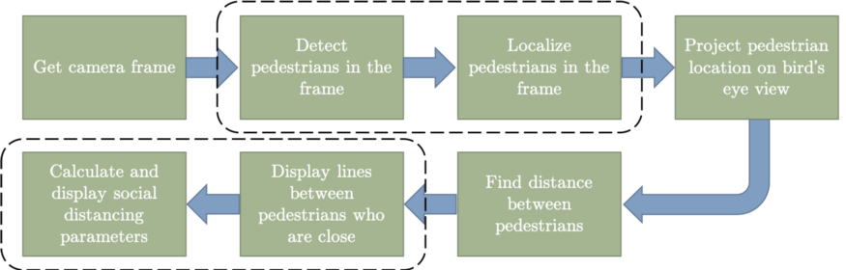
Working

Slide 14
Functional Requirement
Requirement Id | Requirement | Must/Want
FR01 | Monitor distance between two individuals. | Must
FR02 | Monitor distance between people in public places. | Must
FR03 | Showing alert red boxes on the people who don't maintain safe distance of 6 feet. | Must
FR04 | Showing alert green box on the people who have distance greater than 6 feet. | Must
FR05 | Automatic announcement when people not maintaining safe distance . | Want

Slide 15
Non Functional Requirement
Performance: The user can monitor any number of camera windows and also view social distance detection on same.
Scalability: The software can remain stable while adapting any changes and upgrades.
Usability: The software is interactive and easy to use.

Slide 16
System Requirements
Hardware Requirement
CCTV Camera or any other video source.
RAM 4 GB or more
CPU Intel core or better.
Software Requirement
Python 3.5.2
Open cv(CV2) 4.2.0
numpy 1.14.5
For person detection: yolov3

Slide 17
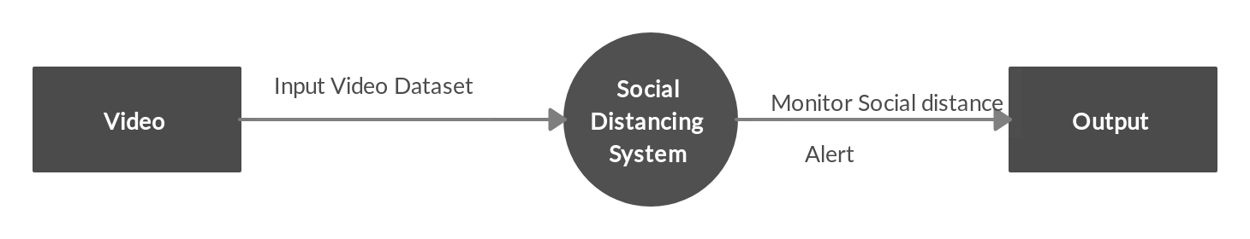
Data Flow Diagram level 0

Slide 18
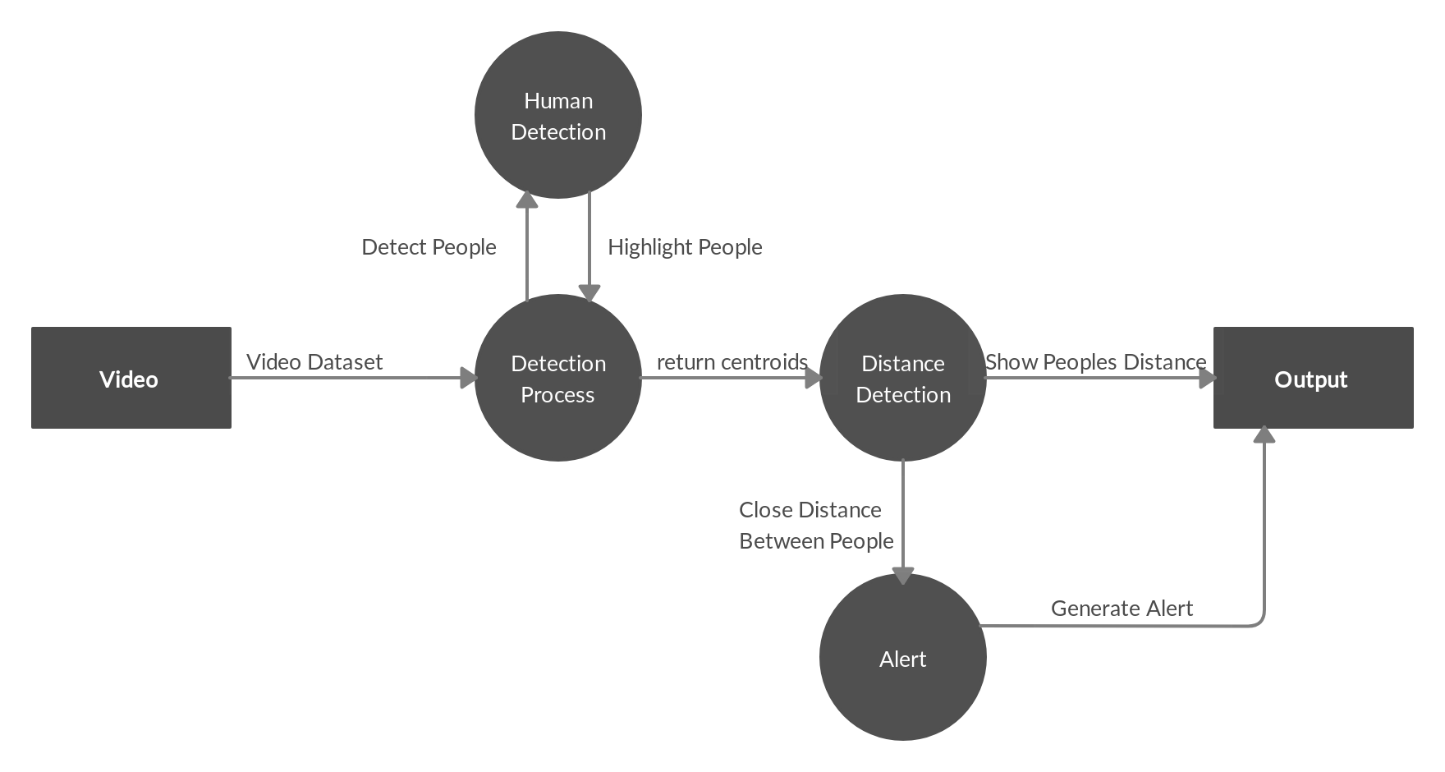
Level 1

Slide 19
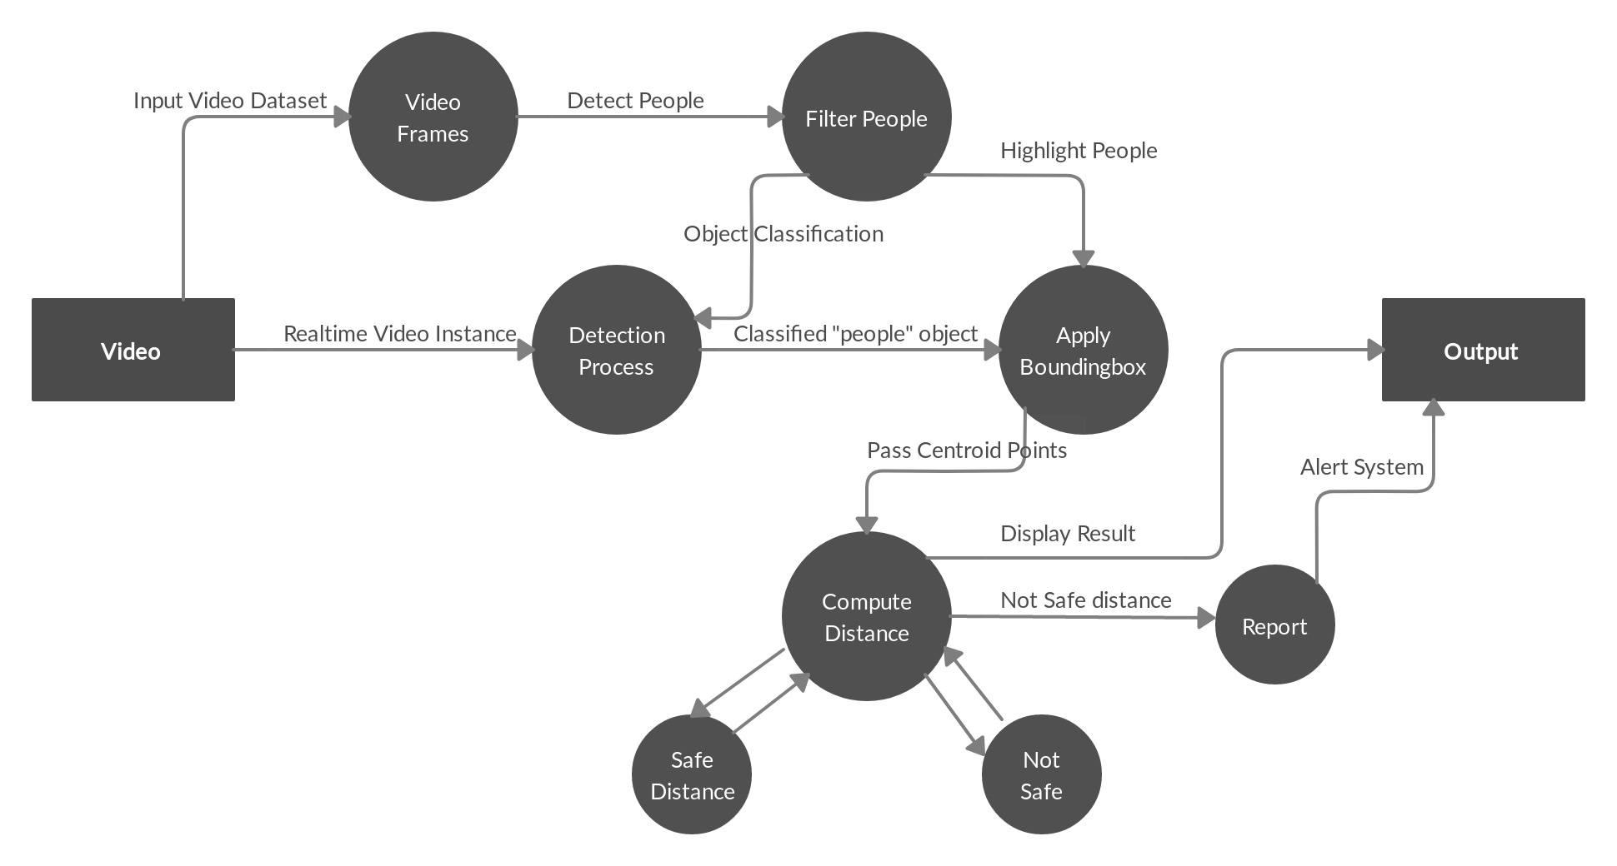
Level 2

Slide 20
UML Diagrams (Unified Modeling Language)

Slide 21
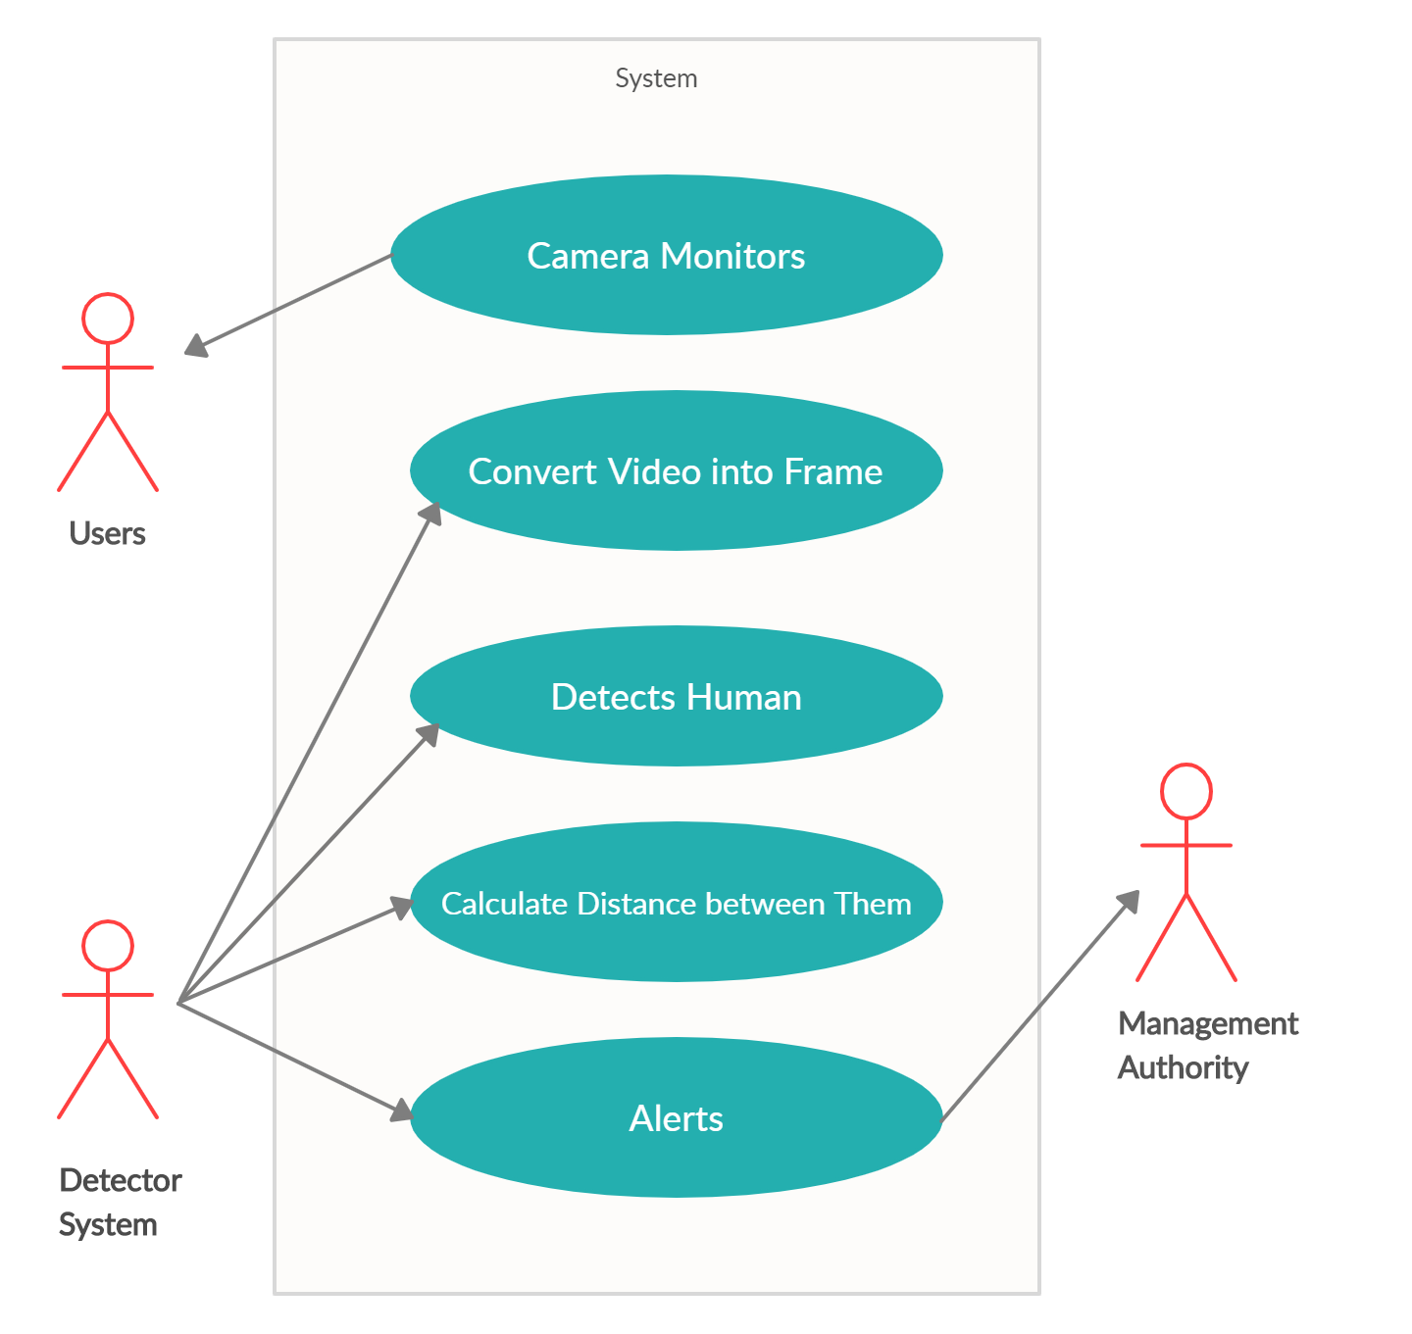
Use Case Diagram

Slide 22
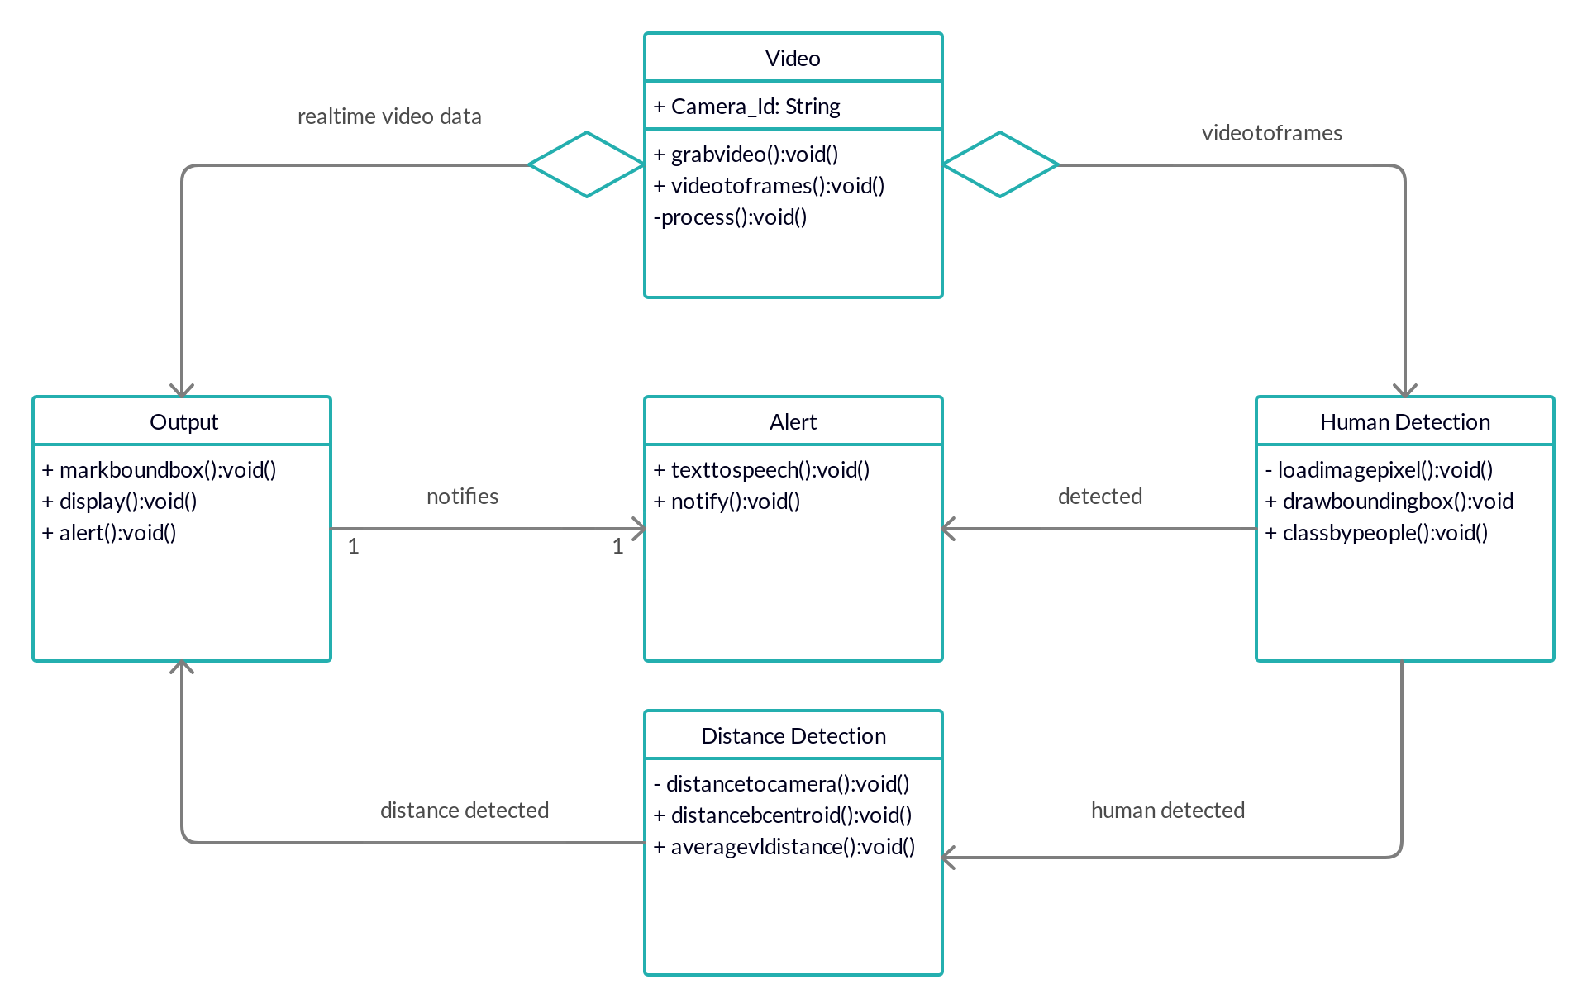
Class Diagram

Slide 23
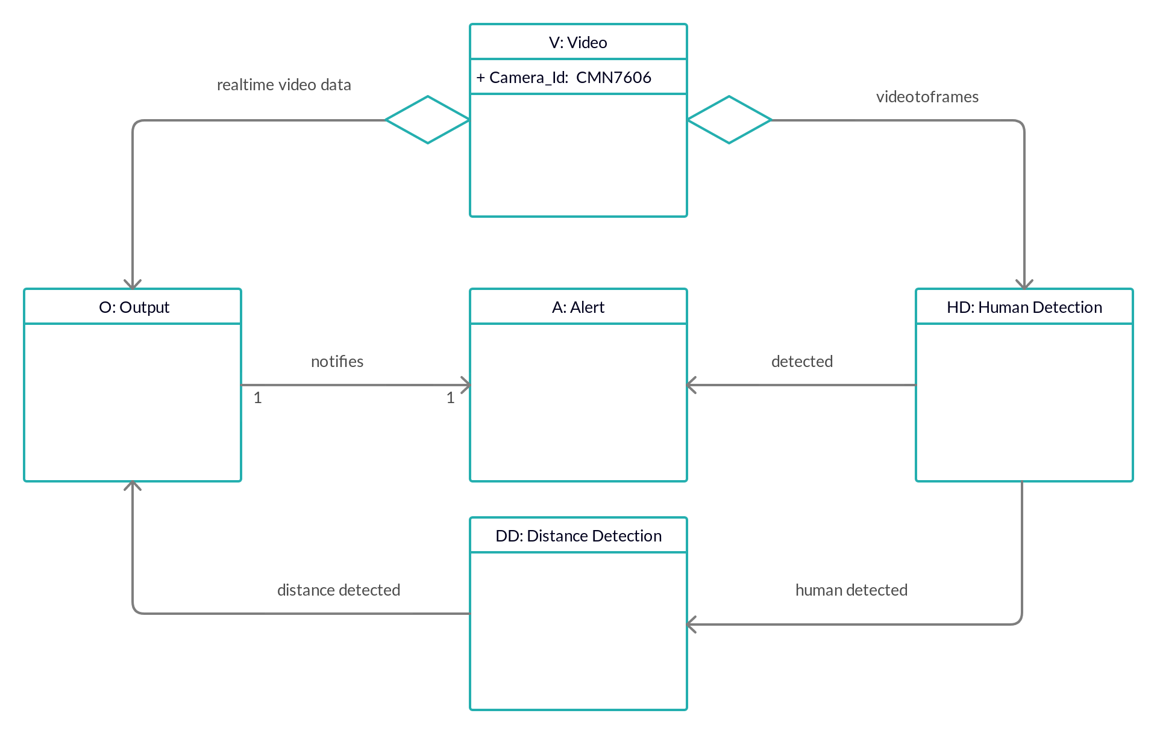
Object Diagram

Slide 24
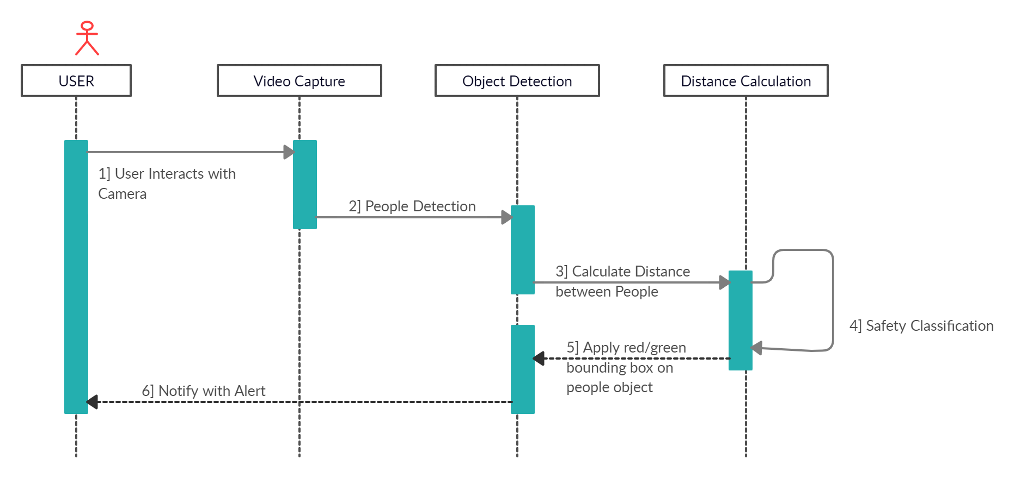
Sequence Diagram

Slide 25
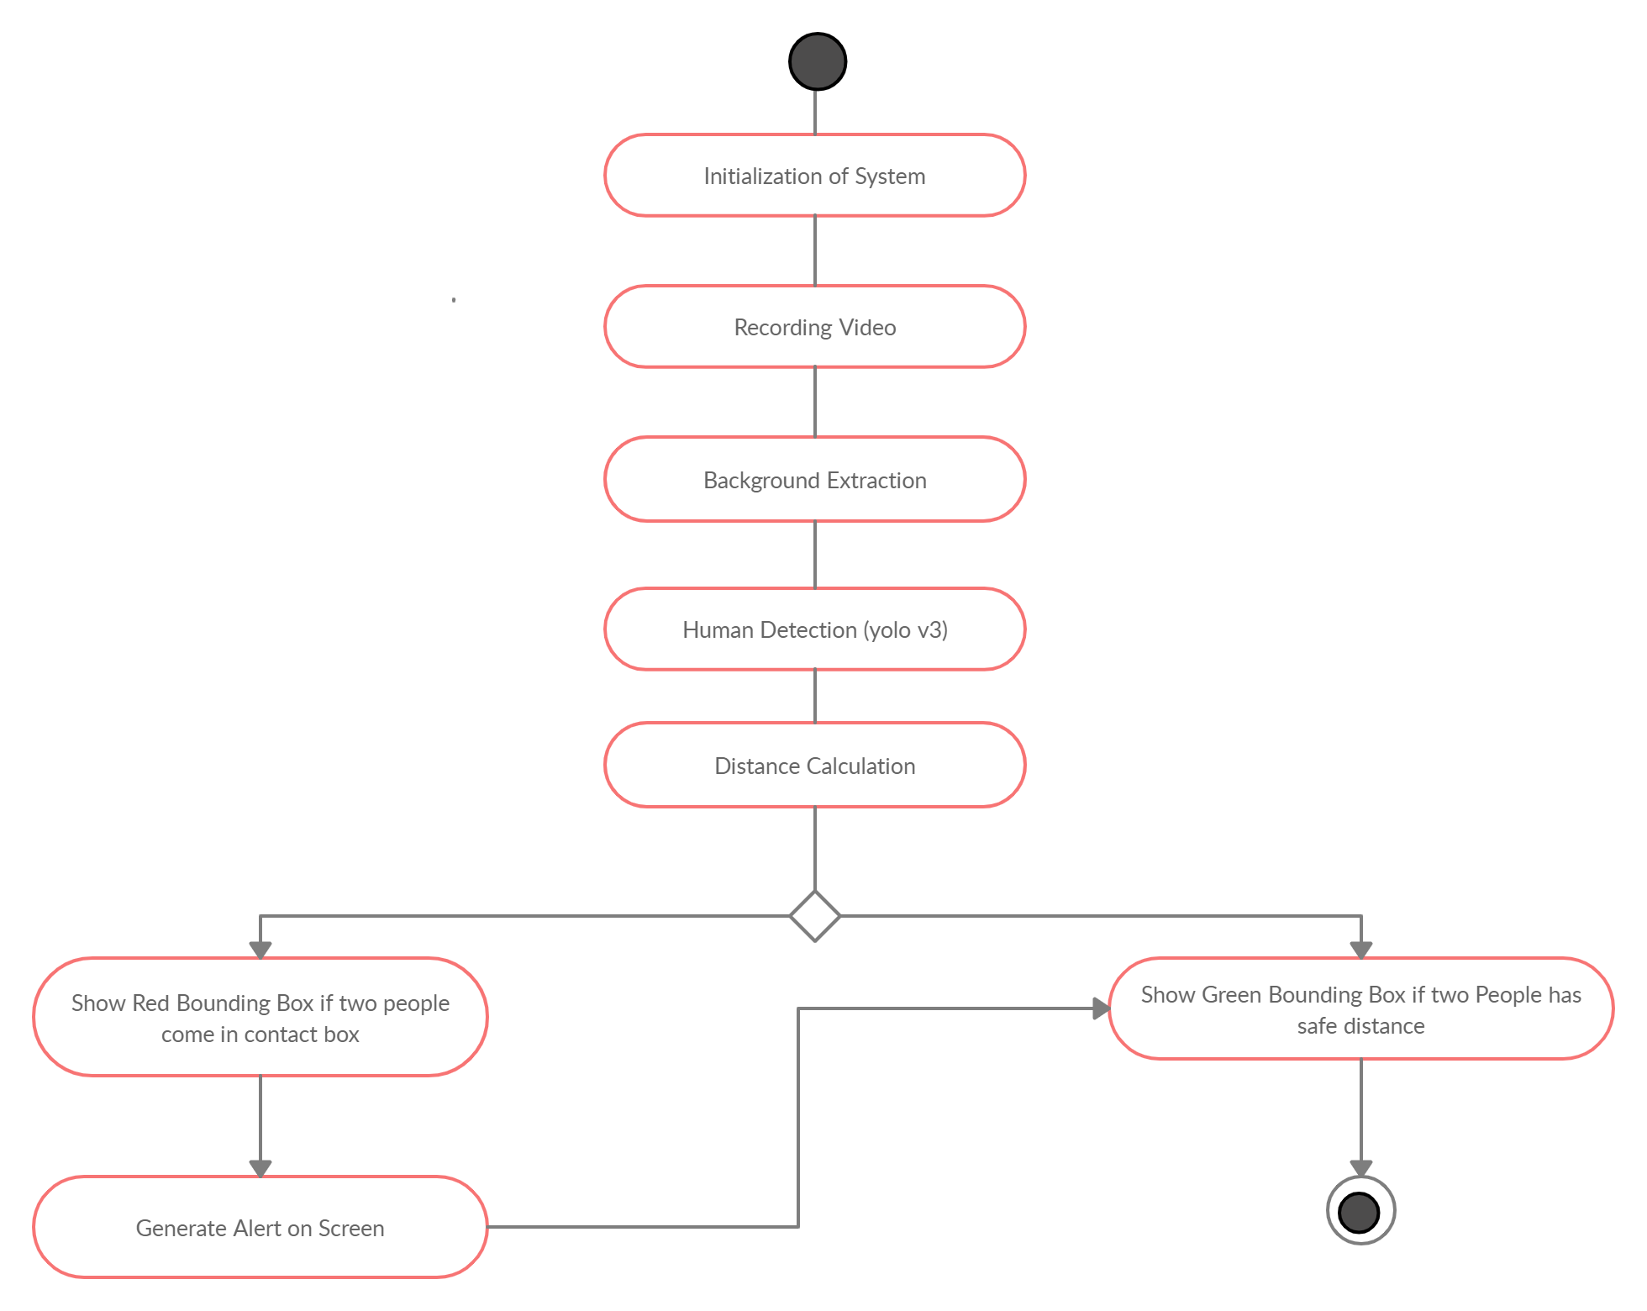
Activity Diagram
No
Yes

Slide 26
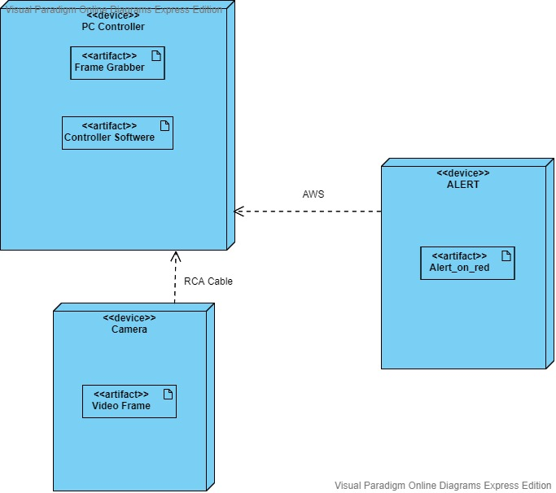
Deployment Diagram

Slide 27
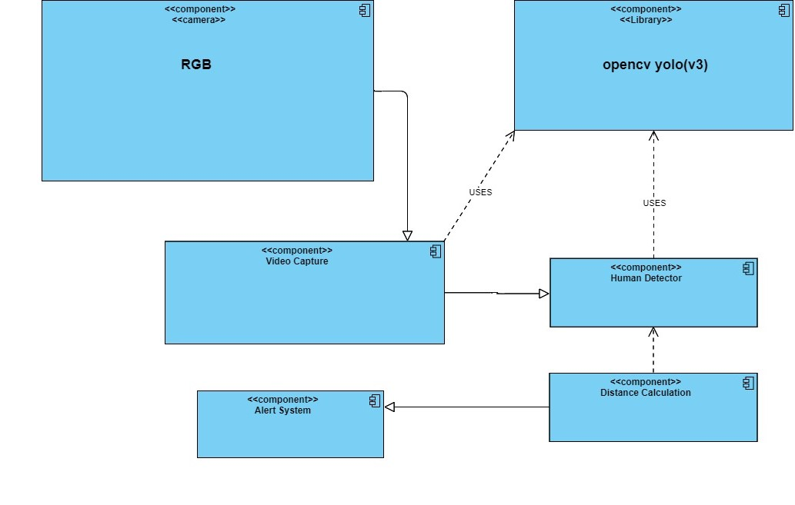
Component Diagram

Slide 28
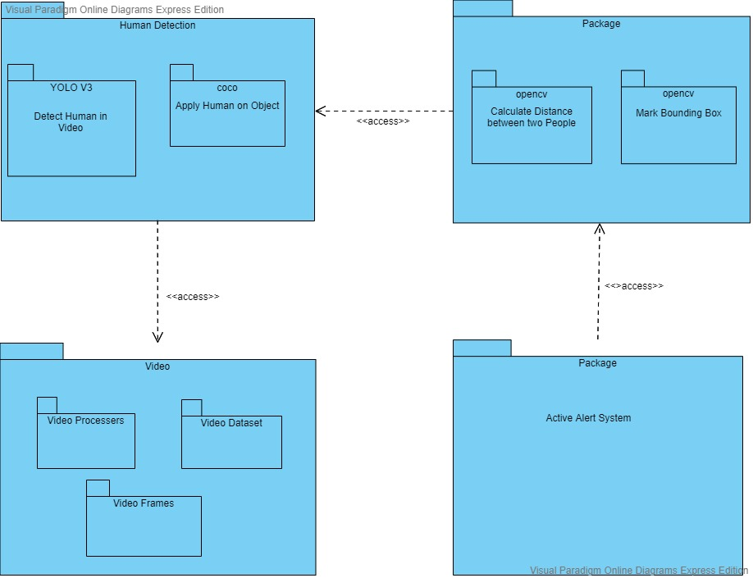
Package Diagram

Slide 29
Algorithm
We’ll be using the YOLO object detector to detect people in our video stream.
Calculate distance between two points(Euclidean Distance).
Convert center coordinates into rectangle coordinates
Filter the person class from the detections and get a bounding box centroid for each person detected.
Check which person bounding boxes are close to each other.
Display risk analytics and risk indicators.

Slide 30
RMMM Plan
The R.M.M.M (Risk Mitigation Monitoring and Management) plan is a document in which all the risk analysis activities are described.
Risk:
Power cutoff. Possible loss that may occur. Market risk of having same application.
Mitigation: Mitigation means preventing/avoiding the risk to occur.
Risks such as error in displaying video due to poor connectivity.
Perform periodical check on the connectivity between camera and system.

Slide 31
Monitoring: objective of risk monitoring is to check whether the predicted risks really occur or not.
To gather the information which can be useful for analyzing the risk.
If any kind of issue occurs whaThe t is the depth of that issue.
Management: The art of dealing all the problems risk in a proper way.
Proper interaction is scheduled again with the customer to resolve the problems.

Slide 32
Risk Mitigation

Slide 33
Technical Risk
​ | RISK​ | MITIGATION​
1. Performance ​ | ​ ​ ​ Due to Poor Performance Of Hardware May Affect The Software​. ​ | ​ Before Installing The System, We Should Check The Hardware Carefully​.
2. Technology​ | ​ ​ ​ Use Of Old Technology In Existing System May Affect The System With ​competitors. | The Technology Should Be Upto Date​. ​

Slide 34
External Risk
​ | RISK​ | MITIGATION​
​ Customer​ ​ | ​ ​ ​ ​ If The Software Is Not As Per User Expectations​. ​ ​ ​ | ​ Responding to the Customer For Complaints And Keep Him Motivated​. ​

Slide 35
Organizational Risk
​ | RISK​ | MITIGATION​
1.Budget​ ​ | ​ ​ ​If Any Further Changes Made In Future May Affect Budget Of Software.​ | With Proper Planning Of Project The Problem Can Be Solved​.

Slide 36
Project Management Risk
​ | RISK​ | MITIGATION​
1. Schedule​ | ​ ​ ​Development Affected if scheduling of project is not proper.​ | Scheduling should be done with proper planning.​
2.Deadline​ | ​ ​ ​If the project is not completed on time it may affect the customers review.​ | Proper time completion of tasks can solve this problem.​

Slide 37
Functional Point Analysis
Function Point Analysis (FPA) is a method of Functional Size Measurement. It assesses the functionality delivered to its users, based on the user's external view of the functional requirements.
The principal of FPA is that a system is decomposed into functional units.
Input: Information entering the system
Output: Information leaving the syetem

Slide 38
Enquiries: Requests for instant access information
Internal Logical File: Information held within the system.
External Logical File: Information held by other system i.e. used by system being analyzed.
Transactional Functional type: EI - External Input EO - External Output EQ - External Enquiry
Data Functional Type: ILF - Internal Logical File EIF - External Interface File

Slide 39
Calculate the unadjusted function points (UFP)
Calculate the adjusted function point (AFP)
CAF = Complexity adjustment factor
AFP = UFP * CAF
EI = 10(low complexity), EO = 13(high complexity)
EQ = 4(Average complexity), EQ = 2(High Complexity)
ILF = 2(Average Complexity), EIF = 9(low complexity)
EI = 10*2 = 20 EO = 13*5 = 65
EQ = 4*3 = 12 EQ = 2*5 = 10
ILF = 2*10 = 20 EIF = 9*5 = 45

Slide 40
Total UFP = 172.
CAF = 0.65 + (0.01 * sum(Fi))
Sum(Fi) = Total complexity adjustment value.
Fi are the degree of influence and are based on responses to the standard qualities.
Number of factors considered.
Does the system require relaible camera backup. (Essential = 5)
Is data communication is required (Essential = 5)
Performance (Essential = 5)
Distributing Processes (Average = 3)
sum(Fi) = 18.
CAF = 0.83
Total AFP = 172 * 0.83
= 143

Slide 41
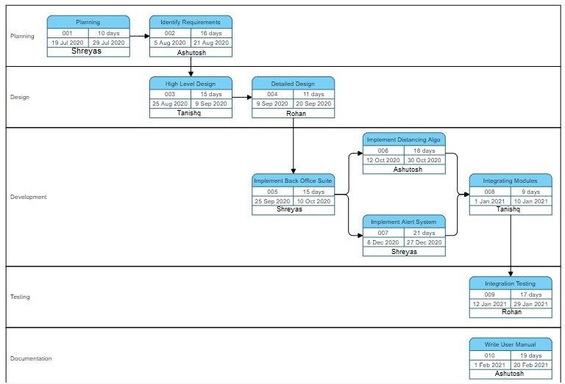
Program Evalution Review Technique (PERT)

Slide 42
Project Cost
The project cost can be found using any one of the model.
COCOMO-1 Model
COCOMO-2 Model
Model -1: The basic COCOMO model computes software development efforts as a function of program size expressed in estimated lines of code.
Model-2: The intermediate COCOMO model computes software development efforts as a function of program size and a set of cost drivers that include subjective assessment of the product, hardware, personnel, project attributes
Model-3: The advanced COCOMO model incorporates all characteristics of the intermediate version with an assessment of the cost drivers impact on each step of the software engineering process.

Slide 43
The basic COCOMO -2 model equations take form:
E=A(b)KLOC B(b)
D=C(b)E D(b)
Where E is the effort applied in person months. D is development time in chronological month.
KLOC is estimated as number of delivered lines of code for the project. This project can be classified as Semidetached software project. The rough estimate of number of lines of this project is 1080. Hence according COCOMO -2 model the time required for completion of the project is 9 months.
Cost of Project:
Equation for calculation of cost of project using COCOMO - 2 model is:
C = D * C p

Slide 44
Where,
C = Cost of project
D = Duration in month
C p = Cost incurred per person-month, C p =Rs.1000/- (per person-month) (approx.)
C = 8 * 1000 = 8000/-
Hence according COCOMO - 2 model the cost of project is 8000/-(approx.)
Time Estimates
The time estimate of this project is approximate 8 months.

Slide 45
Project Modules
1. Home
2. Sign Up
3. Login
4. user Home
5. Social Distance Detection

Slide 46
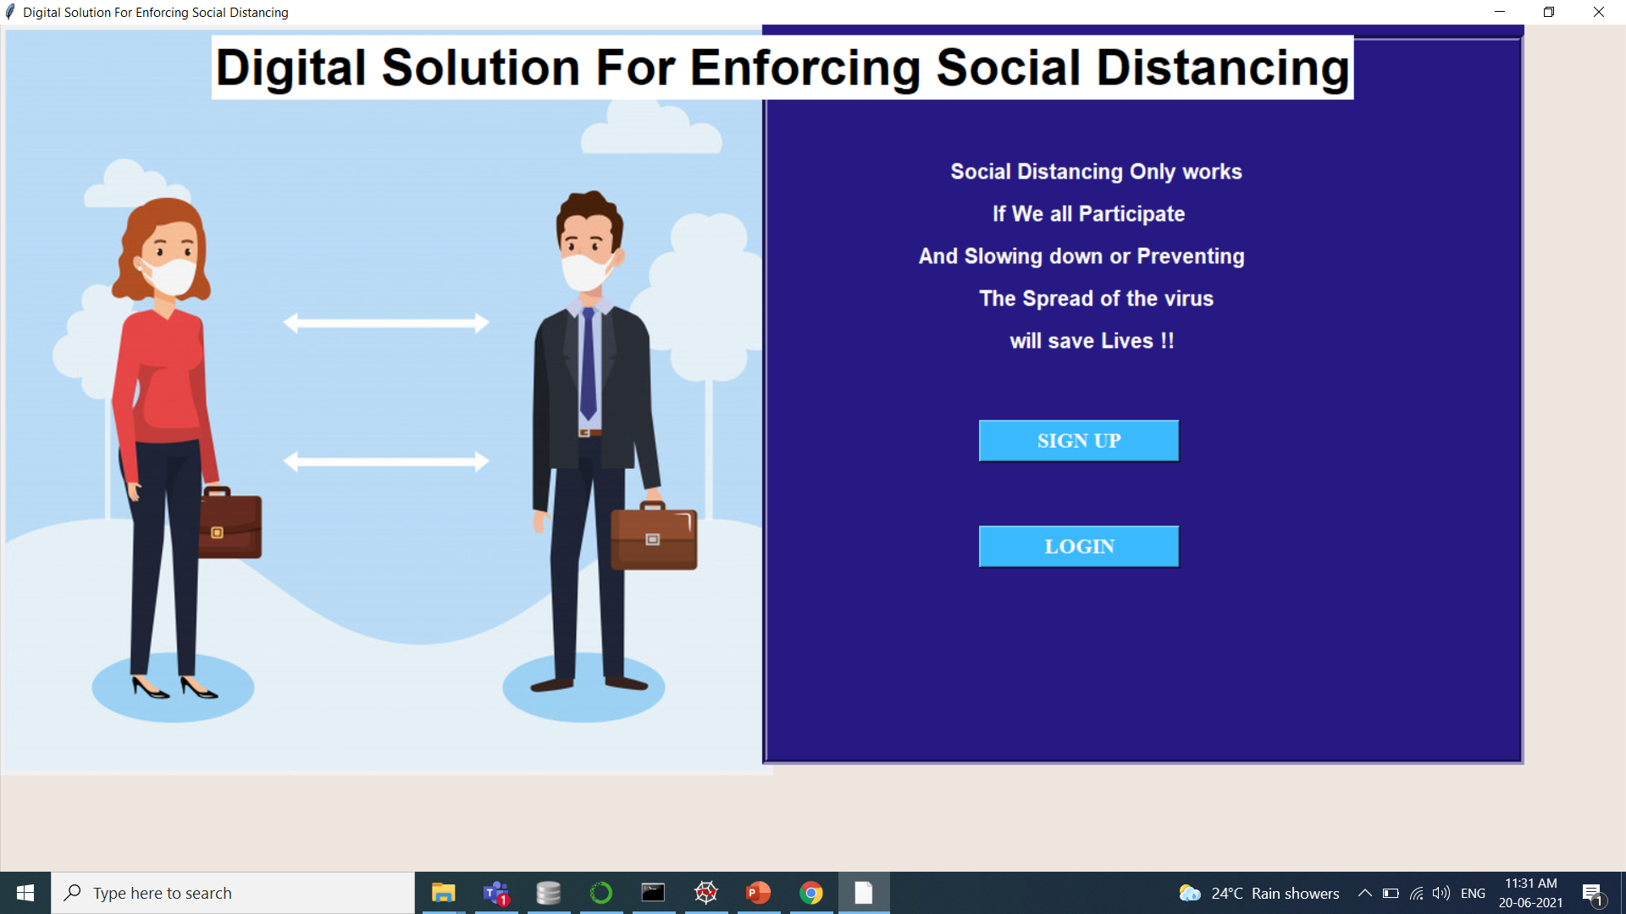
Home

Slide 47
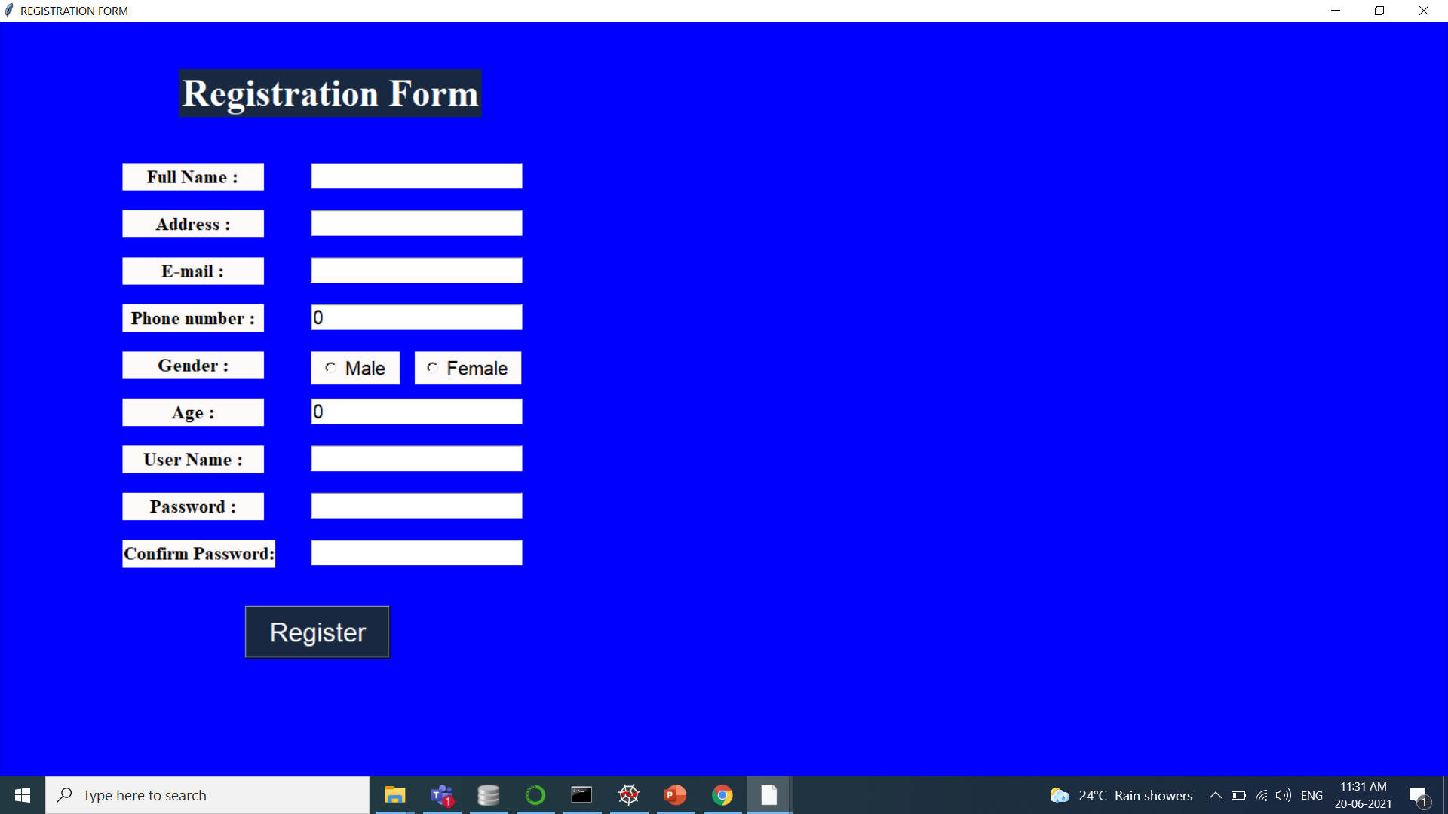
Sign Up

Slide 48
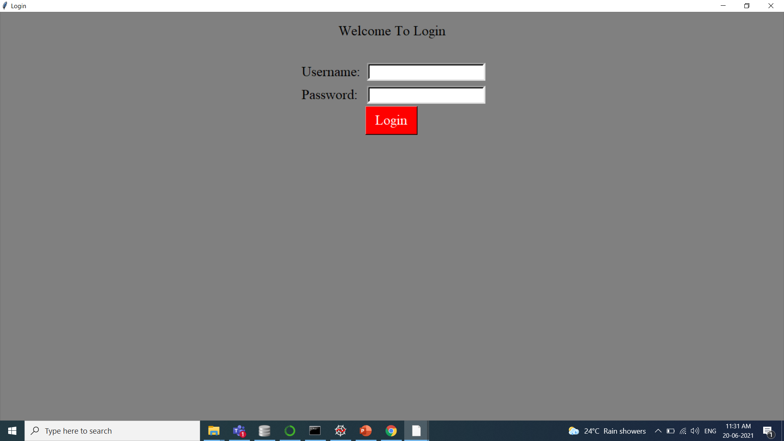
login

Slide 49
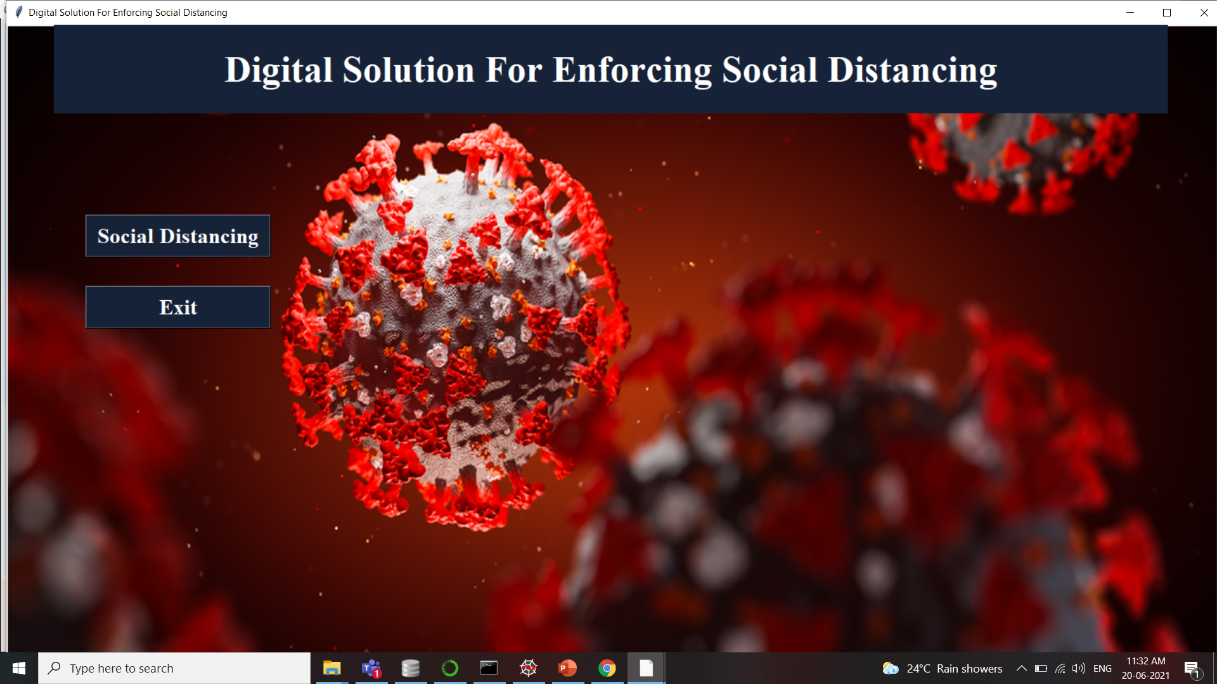
User Home

Slide 50
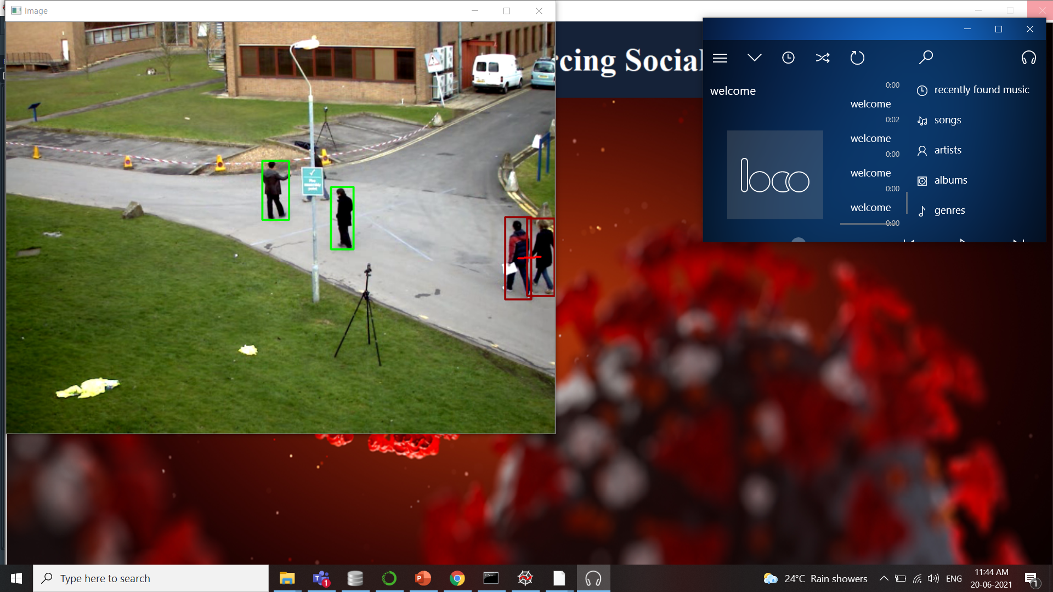
Social Distance Detection

Slide 51
Refrences
1. W. H. Organization, “WHO corona-viruses (COVID-19),” https://www.who.int/emergencies/diseases/novel-corona-virus-2019,2020, [Online;accessed May 02,2020].
2. F. Ahmed, N. Zviedrite, and A. Uzicanin, “Effectiveness of workplace social distancing measures in reducing influenza transmission: a system-aticreview,”BMCpublichealth,vol.18,no.1,p.518,2018.
3. C. Adolph, K. Amano, B. Bang-Jensen, N. Fullman, and J. Wilkerson, “Pandemic politics: Timing state-level social distancing responses to covid-19,” medRxiv,2020.

Slide 52
3. J. Redmon, S. Divvala, R. Girshick, and A. Farhadi, “You only look once:Unified,real-timeobjectdetection,”inProceedingsoftheIEEE
4. N. S. Punn, S. K. Sonbhadra, and S. Agarwal, “Covid-19 epidemic analysis using machine learning and deep learning algorithms,” medRxiv, 2020. [Online]. Available: https://www.medrxiv.org/content/early/2020/04/11/2020.04.08.20057679
5. N. Sulman, T. Sanocki, D. Goldgof, and R. Kasturi, “How effective is human video surveillance performance?” in 2008 19th InternationalConferenceonPatternRecognition.IEEE,2008,pp.1–3.
6. S.Brutzer,B.Ho¨ferlin,andG.Heidemann,“Evaluationofbackgroundsubtraction techniques for video surveillance,” in CVPR 2011. IEEE,2011, pp.1937–1944.
7. . Krizhevsky, I. Sutskever, and G. E. Hinton, “Imagenet classification with deep convolutional neural networks,” in Advances in neural infor-mationprocessingsystems,2012,pp.1097–1105.

Slide 53
THANK YOU…

